Slide 1
Research on Stock Earning Impact
FRE-GY 6883 Financial Computing Team Project

Slide 2
Summary
In this project, our team investigated the relationship between Russell 3000 stocks’ earning surprise percentage and their CAAR (Cumulative Average Abnormal Return) based on IWV benchmark before and after the earning announcement date.
We divided all Russell 3000 stocks equally into 3 groups (beat, meet and miss) according to their earning surprise percentage and implemented bootstrapping 40 times with batch size 80 to all 3 groups. We found that in general, stocks with higher surprise percentage would have higher CAAR after earning announcement date.

Slide 3
Project Design Diagrams
P A R T 0 1

Slide 4
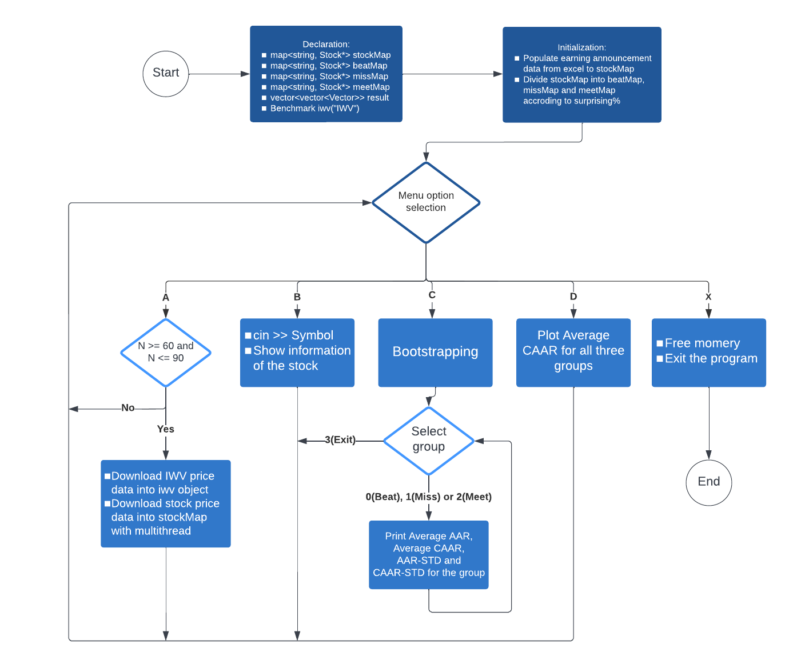
P A R T 0 1
Flow Chart

Slide 5
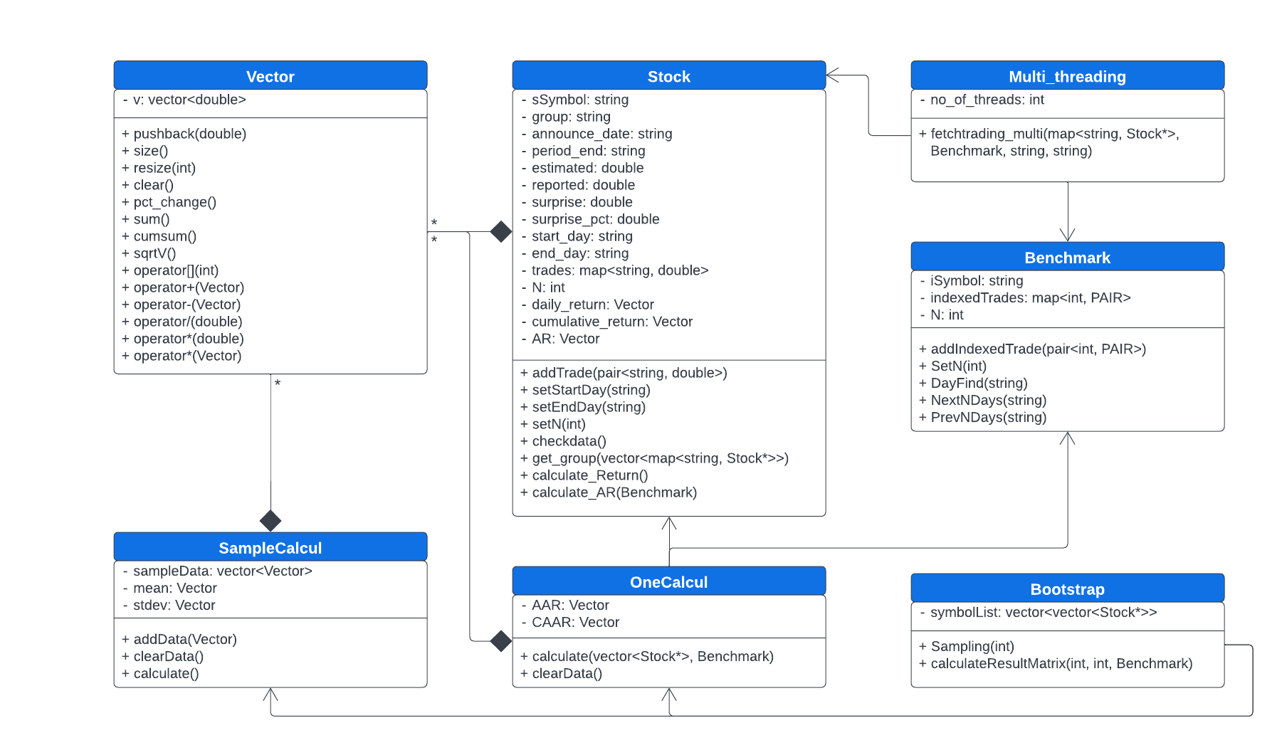
P A R T 0 1
Class UML Diagram

Slide 6
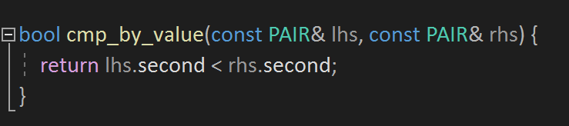
P A R T 0 1
Group Selected Stocks
We created three individual map containers to group stock pointers.
We used vector<pair<string, double>> stockSurp to realize the sorting according to surprise% since map is always sorted by keys.
Function defining the sorting rule
Sorting symbols by surprise% in ascending order
We created map<string, Stock*> beatMap, meetMap, missMap based on stockSurp and stockMap.

Slide 7
Class declaration
&
Data structures
P A R T 0 2

Slide 8
P A R T 0 2
Class: Benchmark
Data and Function related to benchmark
Typedef pair<string, double> PAIR
Private Data:
User defined data type to store pair of ticker and surprise %
String iSymbol
map <int, PAIR> indexedTrades
int N
Store the benchmark data in the map
Public Member Function:
getSymbol( )
getIndexedTrades( )
getN( )
addIndexedTtade( )
DayFind( )
NextNDays( )
PrevNDays( )
Get private data
Some firms release report on weekends (eg: CE, ON), so we will need to adjust the day0 to next trading day.
Find for the previous N days before the announcement date and Next N days after the announcement date

Slide 9
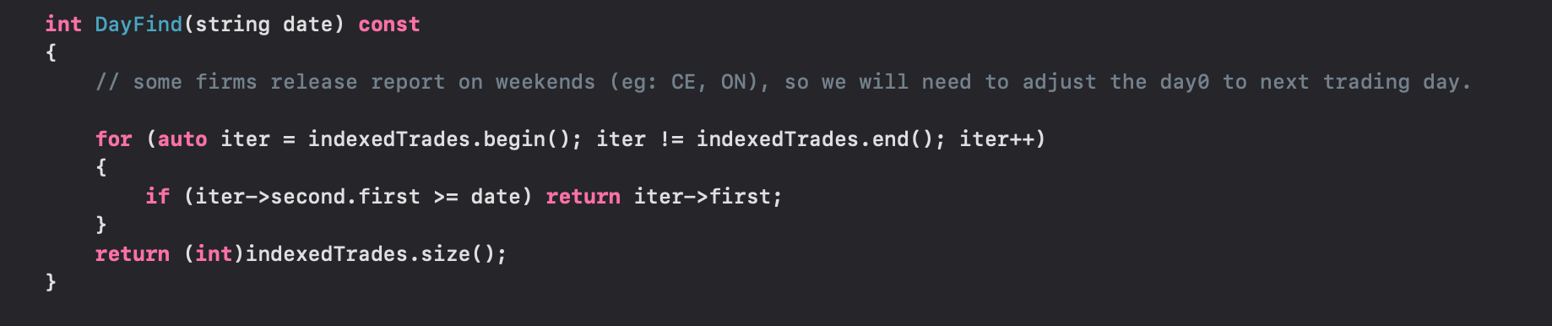
P A R T 0 2
Class Benchmark: DayFind( )
Used to adjust day0 if the announcement date is in the weekend
Go through the iterator to check whether we need to adjust date

Slide 10
Class Muti_threading: Retrieve price data
P A R T 0 2
int no_of_threads;
void fetchtrading_multi(map<string, Stock*>& stockMap, const Benchmark& benchmark, const string &url_common, const string &api_token)
01
Populate startday, endday, N using benchmark.PrevNDays(annouceday), NextNDays, GetN()
Record the stock symbols in stockTickers in the same order as stockMap
stockmap
vector<string> stockTickers
02
sub_stockmap_list store all sliced stock map
threads.emplace_back(thread(fetchtrading, ref(sub_stockMap_list[i]), url_common, api_token))
vector<map<string, Stock*>> sub_stockMap_list;
vector<thread> threads;

Slide 11
Single Thread
P A R T 0 2
int fetchtrading(map<string, Stock*>& stockMap, string url_common, string api_token)
Iterate over stockmap
Get startday/endday from stock pointer
Use Libcurl to fetch data and store in the stock object
iter->second->addTrade(make_pair(sDate, dValue));
iter->second->addTrade(make_pair(sDate, dValue));
warning for stocks with less than 2N+1 price data
if (iter->second->getTrades().size() != 2 * iter->second-> getN() + 1) {
cout << iter->first << '\t' << iter->second->getTrades().size() << endl;

Slide 12
Class: Stock
Pull information for one stock from one group
Private Data:
Symbol
Group
Announce_date
Period_end
estimated
reported
surprise
surprise_pct
start_day
end_day
map<string, double> trades
Vector daily_return
Vector cumulative_return
Vector AR
Store stock data in the map. Key is the trading date, and value is the daily price
User-defined data type Vector: to store
vector <double>
Public Member function:
getSymbol( )
getAnnounceDay( )
…….
Vector getReturn( )
Vector getCumulativeReturn( )
Vector getAR( )
……
……
ostream& operator<<(ostream& ostr, const Stock& stock)
Get Private data
Overload cout to get stock information

Slide 13
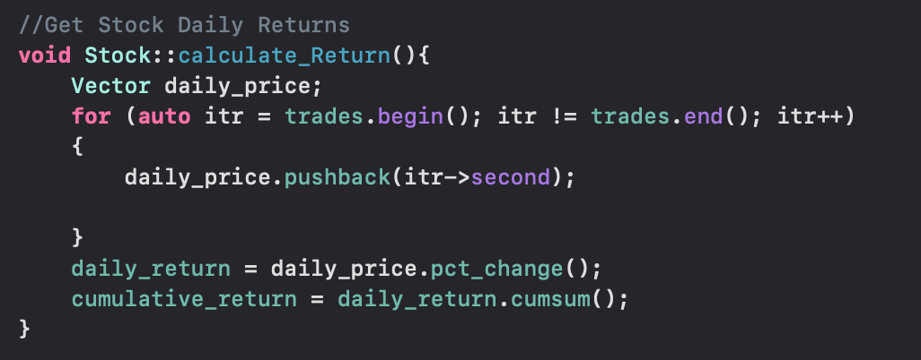
P A R T 0 2
Class Stock: Calculate_Return( )
Use our own Vector class to store daily price
We use some Vector calculation function inside the class Vector to calculate the percentage change and cumulative return

Slide 14
Class Vector
P A R T 0 2
Compared with STL vector, the Vector class stores a vector<double>.
It has some extended advanced vector calculation functions.
For example:
Vector pct_change()const; // percentage change can be used to calculate the daily return
Vector cumsum()const; // cumulative sum can be used to calculate the CAAR
We also did operator overloading for common vector calculations (+, -, *, /)

Slide 15
Class Stock: Calculate_AR( )
P A R T 0 2
Vector calculate_AR(const Benchmark& benchmark);
This member function returns the Abnormal Return vector of the stock.
How it works:
Step 1: Get the daily price and then calculate the daily return of IWV of the
corresponding time period
Step 2: Calculate the Abnormal Return
AR = daily_return - iwvReturn;
return AR;
Vector iwvPrice;
Vector iwvReturn = iwvPrice.pct_change();

Slide 16
Class OneCalcul
P A R T 0 2
Use this class to calculate the AAR and CAAR of a group of stocks.
Structure of this class:
Vector AAR;
Vector CAAR;
void calculate(vector<Stock*> stockList, const Benchmark& iwv);
Given a vector of pointers to stock objects in a group and the benchmark, this function will calculate the AAR and CAAR of this stock group and store the result in Vevtor AAR and Vector CAAR.

Slide 17
Class SampleCalcul
P A R T 0 2
Used to store the result of AARs or CAARs of 40 sampling of 1 group and calculate mean & std
Private data member:
vector<Vector> sampleData
Vector mean
Vector stdev
Store AAR(CAAR) of 40 sampling
Public member function:
addData(Vector v)
calculate()
getMean()
getStd()
Called after each sampling to store results
Called after all the sampling to use sampleData to calculate Ave AAR(CAAR) & AAR std(CAAR std) and store in mean & stdev
Return mean(stdev)

Slide 18
Class Bootstrap
P A R T 0 2
Used to generate random number to do the sampling and calculate result matrix of 3 group
Private data member:
vector<vector<Stock*>> symbolList
Store all the stock pointers that have enough data
symbolList.size() = 3
symbolList[i].size() = num of stocks with enough data in each group
Public member function:
constructor with a parameter (parameter: vector of map of 3 group)
Set seed for random number generator
go through 3 map & store pointer into symbolList

Slide 19
Class Bootstrap
P A R T 0 2
Public member function:
vector<vector<Stock*>> Sampling(int size)
Generate a sample for 3 group
size: num of sample, in this project 80
Use while loop to ensure 80 different stocks for each group
Size of return: 3x80
vector<vector<Vector>> calculateResultMatrix(int size, int times, const Benchmark& iwv)
size: used when calling the function Sampling
times: times of sampling, in this project 40
do the sampling, call the member function of class OneCalcul to get AAR & CAAR and store.
call the member function of class SampleCalcul to calculate and store the result
Size of return: 3x4x2N

Slide 20
Visualization
&
Gnuplot
P A R T 0 3

Slide 21
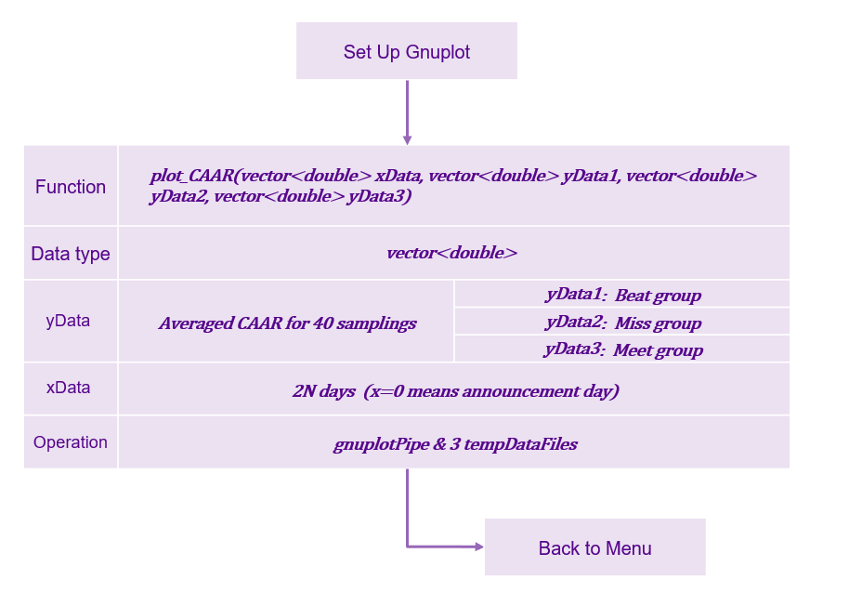
Gnuplot - Averaged CAAR for Beat, Meet, Miss Groups
P A R T 0 3

Slide 22
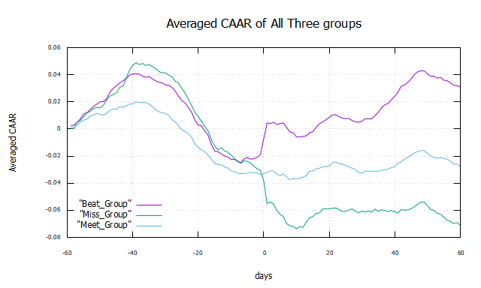
Gnuplot - Averaged CAAR for Beat, Meet, Miss Groups
P A R T 0 3

Slide 23
Conclusion
P A R T 04

Slide 24
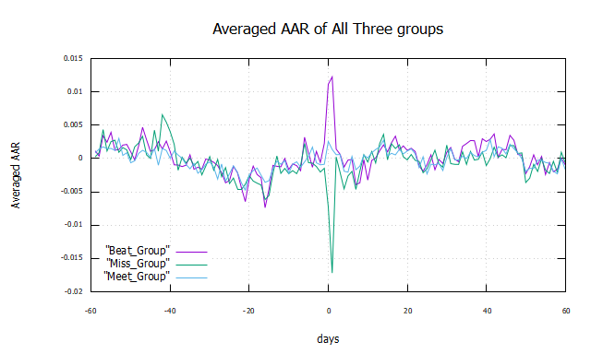
Conclusion
P A R T 0 4
Three groups are sorted by their earnings surprise of 2021 Q2. Earnings reveal the financial health and economic conditions of businesses. An earnings surprise occurs when a company's reported quarterly or annual profits are above or below analysts' expectations. When a company's profit performance fails to match the expectations set by the investment community, investors often express their disappointment by selling shares.
Our group concluded that: earning releases of Russell 3000 stocks have a huge impact on their future stock prices, and stocks with higher surprise will have higher CAAR after earning announcement date. This conclusion can be explained in three aspects from graphs CAAR and AAR as following table:

Slide 25
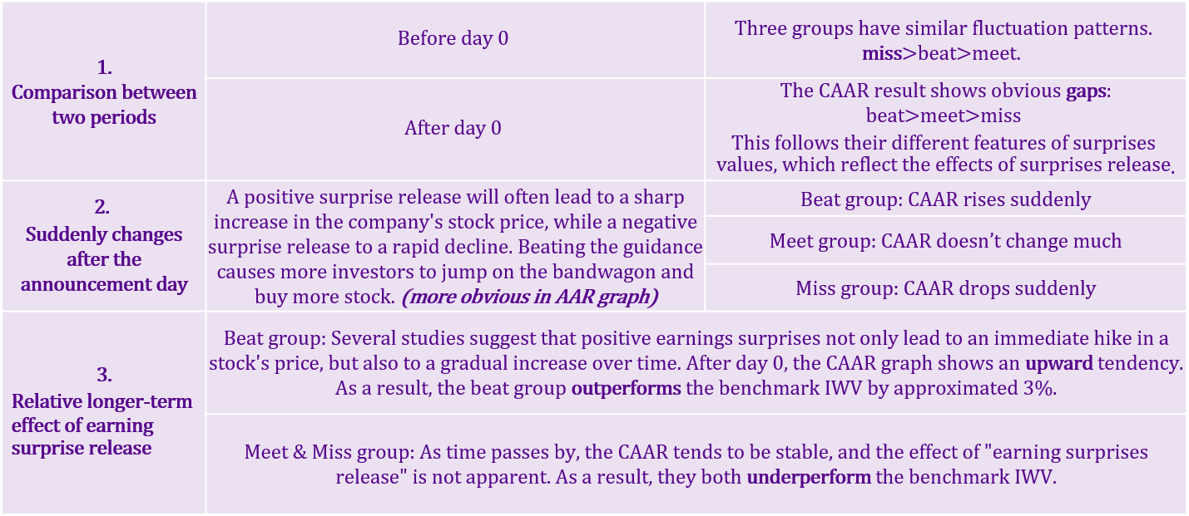
Conclusion
P A R T 0 4

Slide 26
Enhancement
&
Enrichment
P A R T 05

Slide 27
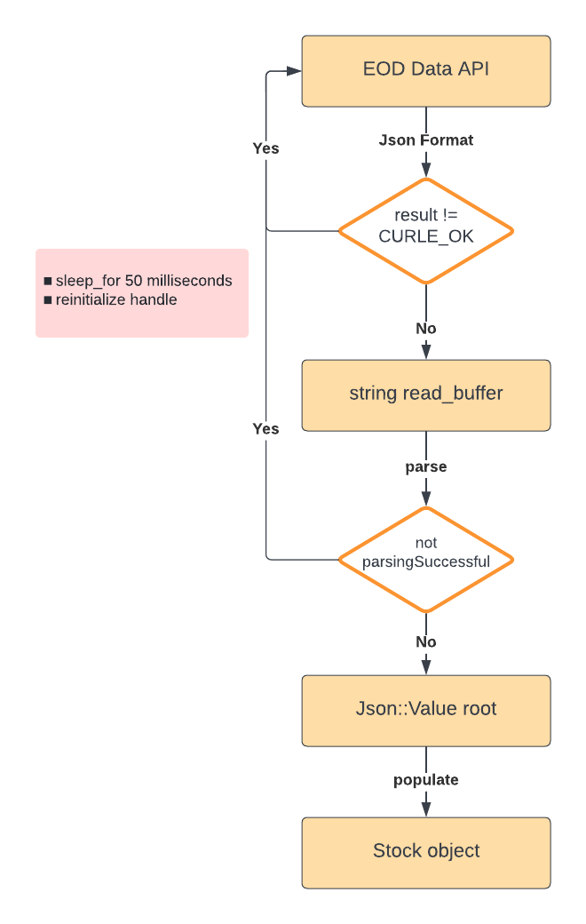
Enhancement & Enrichment
P A R T 0 5
We downloaded json format data from EOD and parsed them into our stock objects for program stability and efficiency.
Fixed issues which might occur when retrieving data from EOD on PC:
Libcurl connection failed
429 Too Many Request error

Slide 28
Reference
P A R T 06

Slide 29
Reference
P A R T 0 6
Multithreading in C++:
https://www.geeksforgeeks.org/multithreading-in-cpp/
How Earnings Affect Stock Prices:
https://money.usnews.com/investing/investing-101/articles/how-earnings-affect-stock-prices
The Impact of Earnings Announcements on Stock Prices:
https://finance.zacks.com/impact-earnings-announcements-stock-prices-4265.html
How to Fix 429 Too Many Requests Error:
https://kinsta.com/knowledgebase/429-too-many-requests/

